Slide 1
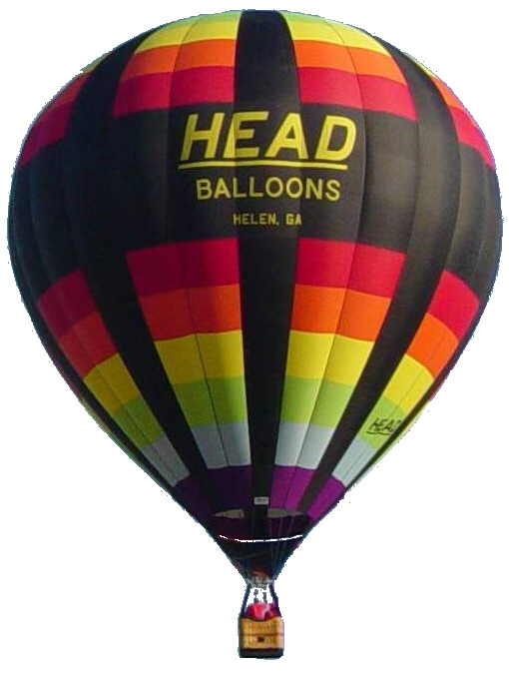
TARP HEAD
HEAD Balloons,Inc
PO Box 28
Helen, GA 30545
800-HEADBALLOONS
www.HEADBALLOONS.com

Slide 2
Maintenance & Preventative Maintenance
Florida Safety Seminar
Lakeland-Linder Regional Airport
March 3, 2018
http://www.headballoons.com/Seminar.html

Slide 3
Areas we will discuss:
(1) Maintenance
(2) Preventative Maintenance
(3) Major & Minor Repairs
(4) Aircraft Parts
(5) Airworthiness Limitations

Slide 4
What is MAINTENANCE & PREVENTIVE MAINTENANCE?
CFR Part 1.1 - General definitions.
Maintenance means inspection, overhaul, repair, preservation, and the replacement of parts, but excludes preventive maintenance.
Preventive maintenance means simple or minor preservation operations and the replacement of small standard parts not involving complex assembly operations.

Slide 5
What CFR’s pertain to MAINTENANCE and PREVENTIVE MAINTENANCE?
CFR Part 43 – MAINTENANCE, PREVENTIVE MAINTENANCE, REBUILDING, AND ALTERATION (Regulations on how the work is done)
CFR Part 91 - Subpart E - Maintenance, Preventive Maintenance, and Alterations (Regulatory Requirement)

Slide 6
Who can work on aircraft?
- CFR Part 43.3 -
(1) FAA CERTIFICATED
- Repairman
- A &P mechanic
(2) NON-CERTIFIED
- Private & Commercial Pilots
- Persons working under supervision of Repairman
or A&P Mechanic
(3) MANUFACTURER

Slide 7
Who can do what?
MAINTENANCE (includes repairs)– A&P Mechanic, Repairman, Person working under supervision
ALTERATIONS – A&P Mechanic, Repair Station, Manufacturer
PREVENTATIVE MAINTENANCE – A&P Mechanic, Repairman, Repair Station, Private or Commercial Pilot
REBUILDING – Manufacturer
INSPECT – Manufacturer, Repair Station, A&P Mechanic with IA (Inspection Authorization designation)

Slide 8
CFR Part 43.3 - Persons authorized to perform preventive maintenance
(g) The holder of a pilot certificate (private or commercial) issued under CFR Part 61 may perform preventive maintenance on any aircraft owned or operated by that pilot …

Slide 9
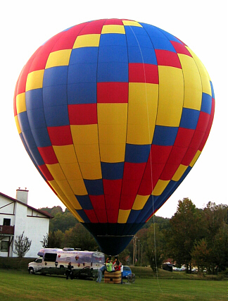
PREVENTIVE MAINTENANCE
Private or Commercial Pilots (NO Student Pilots)
Specific operations allowed are listed in CFR Part 43 - Appx A.
ONLY the operations listed may be performed and signed off.

Slide 10
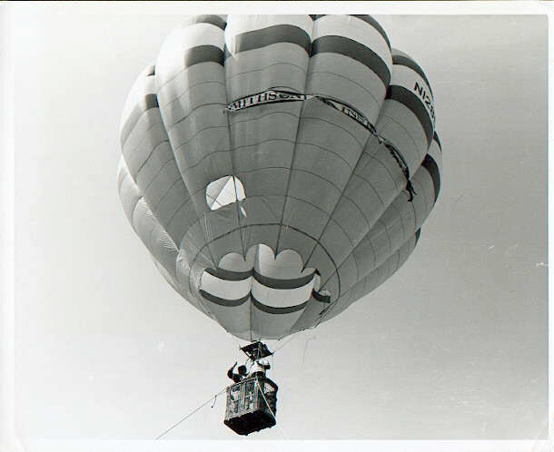
Maintenance or
Preventive Maintenance?

Slide 11
CFR Part 43 APPX A
(c) Preventive maintenance.
Preventive maintenance is limited to the following work, provided it does not involve complex assembly operations:
31 items are listed
**not all items apply to balloons**

Slide 12
CFR Part 43 APPX A
(5) Replacing defective safety wiring or cotter keys.
(6) Lubrication not requiring disassembly other than removal of nonstructural items
(7) Making simple fabric patches not requiring … the removal of structural parts …. In the case of balloons, the making of small fabric repairs to envelopes (as defined in, and in accordance with, the balloon manufacturers' instructions) not requiring load tape repair or replacement.
(9) Refinishing decorative coating of fuselage, balloon baskets, …, when removal or disassembly of any primary structure or operating system is not required.

Slide 13
CFR Part 43 APPX A
(10) Applying preservative or protective material to components where no disassembly of any primary structure or operating system is involved and where such coating is not prohibited or is not contrary to good practices.
(11) Repairing upholstery and decorative furnishings … of balloon basket interior when the repairing does not require disassembly of any primary structure or operating system or interfere with an operating system or affect the primary structure of the aircraft.
(15) Replacing seats or seat parts with replacement parts approved for the aircraft, not involving disassembly of any primary structure or operating system.

Slide 14
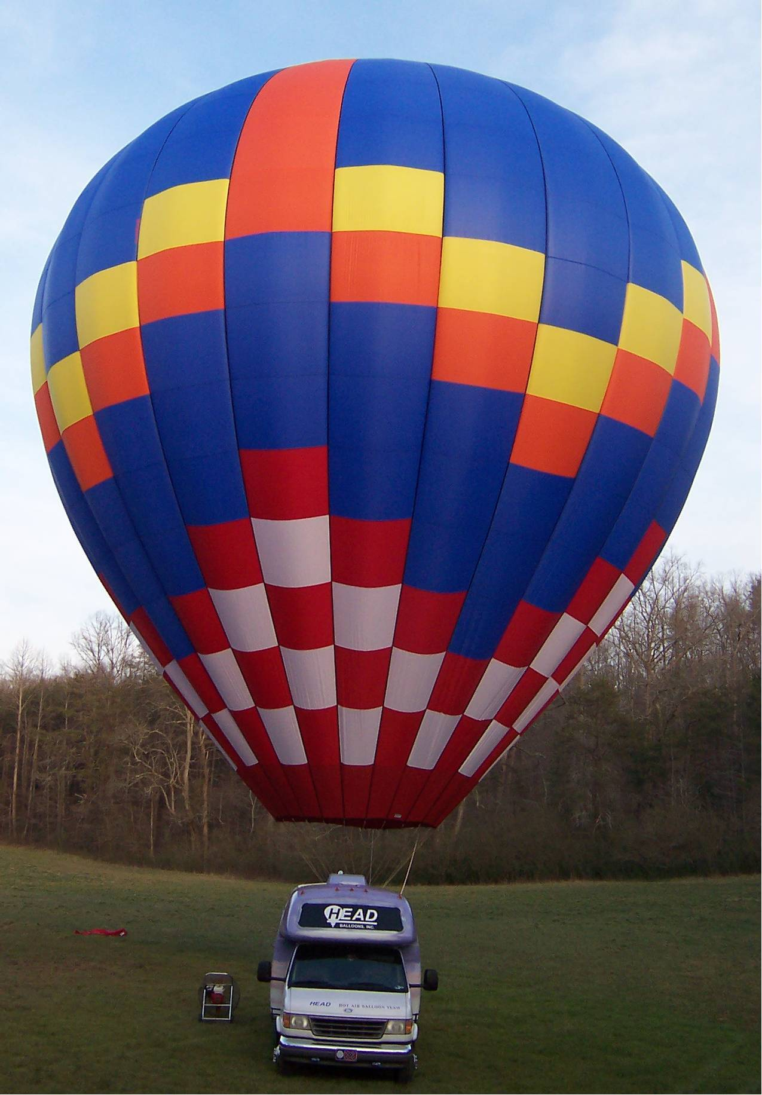
CFR Part 43 APPX A
(21) Replacing any hose connection except hydraulic
connections
(22) Replacing prefabricated fuel lines.
(24) Replacing and servicing batteries.
(25) Cleaning of balloon burner pilot and main nozzles in accordance with the balloon manufacturer's instructions.
(26) Replacement or adjustment of nonstructural standard fasteners incidental to operations.
(27) The interchange of balloon baskets and burners on envelopes when the basket or burner is designated as interchangeable in the balloon type certificate data and the baskets and burners are specifically designed for quick removal and installation

Slide 15
Repairing It Yourself
Check FAR 43 Appx. A - Is it legal for you to do the operation?
Evaluate yourself – are you qualified to do the repair?
Are you equipped to do it ? (Tools, approved parts, instruction manuals, etc…)

Slide 16
Are you QUALIFIED? Are you EQUIPPED?

Slide 17
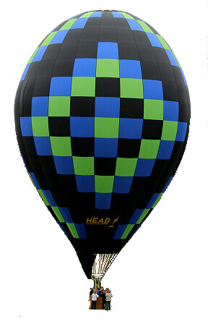
CFR Part 91
Subpart E - Maintenance,
Preventive Maintenance, and Alterations
- 91.401 a) This subpart prescribes rules governing the maintenance, preventive maintenance, and alterations of U.S.-registered civil aircraft operating within or outside of the United States.

Slide 18
CFR Part 91
91.403 General
a) The owner or operator of an aircraft is primarily responsible for maintaining that aircraft in an airworthy condition...

Slide 19
CFR Part 91
91.407 Operation after maintenance, preventive maintenance, rebuilding, or alteration.
(a) No person may operate any aircraft that has undergone maintenance, preventive maintenance, rebuilding, or alteration unless—
(1) It has been approved for return to service by a person authorized under Sec.43.7 of this chapter; and
(2) The maintenance record entry required by Sec.43.9 or Sec. 43.11, as applicable, of this chapter has been made.

Slide 20
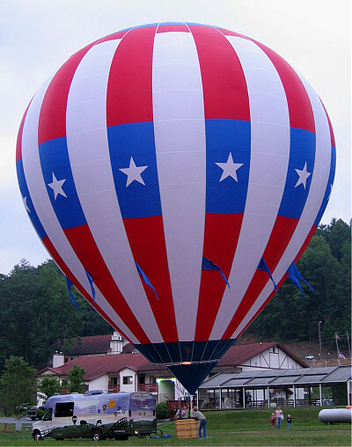
LOGBOOK
- MAINTENANCE ENTRIES
CFR Part 43.9 -
(a) Maintenance record entries. each person who maintains, performs preventive maintenance, rebuilds, an aircraft,
shall make an entry in the maintenance record of that equipment containing the following information:

Slide 21
LOGBOOK
- MAINTENANCE ENTRIES
- CFR 43.9 (a) cont’d
(1) A description of work performed
(2) The date of completion of the work
(3) The name of the person performing the work…
(4)... the signature, certificate number, and kind of certificate held by the person approving the work. The signature constitutes the approval for return to service only for the work performed.

Slide 22
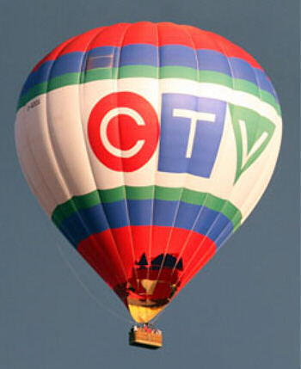
CFR Part 43 Appendix A
Major or Minor?

Slide 23
CFR Part 1.1- General definitions
Major repair means a repair:
(1) That, if improperly done,
might appreciably affect weight, balance, structural strength, performance, powerplant operation, flight characteristics, or other qualities affecting airworthiness; or
(2) That is not done according to accepted practices or cannot be done by elementary operations.
Minor repair means a repair other than a major repair.

Slide 24
CFR Part 1.1 - General definitions
Major alteration means an alteration not listed in the aircraft specifications--
(1) That might appreciably affect weight, balance, structural strength, performance, powerplant operation, flight characteristics, or other qualities affecting airworthiness; or
(2) That is not done according to accepted practices or cannot be done by elementary operations.
Minor alteration means an alteration other than a major alteration.

Slide 25
Major or Minor??
CFR Part 43, App. A
(a) Major alterations
(1) Airframe major alterations. Alterations of the following parts and alterations of the following types, when not listed in the aircraft specifications issued by the FAA, are airframe major alterations:
(v) Control system.
(viii) Elements of an airframe ...
(xii) Changes to the basic design of the fuel systems.
(2) Powerplant major alterations.
(3) Propeller major alterations.
(4) Appliance major alterations. Alterations of the basic design not made in accordance with recommendations of the appliance manufacturer or in accordance with an FAA Airworthiness Directive are appliance major alterations.

Slide 26
Major or Minor?
CFR Part 43, App. A
(b) Major repairs—
(1) Airframe major repairs. Repairs to the following parts of an airframe and repairs of the following types, involving the strengthening, reinforcing, splicing, and manufacturing of primary structural members or their replacement, ..., are airframe major repairs.
(xxi) Repairs involving the substitution of material.
(2) Powerplant major repairs.
(3) Propeller major repairs.
(4) Appliance major repairs. Repairs of the following types to appliances are appliance major repairs:
(i) Calibration and repair of instruments..

Slide 27
MAINTENANCE ENTRIES
CFR Part 43, Appendix B
—Recording of Major Repairs and Major Alterations
(a) Except as provided in paragraphs (b), (c), and (d) of this appendix, each person performing a major repair or major alteration shall—
(1) Execute FAA Form 337 at least in duplicate;
(2) Give a signed copy of that form to the aircraft owner; and
(3) Forward a copy of that form to the local Flight Standards District Office within 48 hours after the aircraft, airframe,
aircraft engine, propeller, or appliance is approved for return to service.

Slide 28
MAINTENANCE ENTRIES
If the work is a Major Repair or Major Alteration a 337 Form is required to be filed – in some cases, in lieu of a 337 a Certified Repair Station may use their Work Order

Slide 29
MAINTENANCE ENTRIES
(b) For major repairs made in accordance with a manual or specifications acceptable to the Administrator, a certificated
repair station may, in place of the requirements of paragraph (a)—
(1) Use the customer's work order upon which the repair is recorded;
(2) Give the aircraft owner a signed copy of the work order and retain a duplicate copy for at least two years from the
date of approval for return to service of the aircraft, airframe, aircraft engine, propeller, or appliance;
(3) Give the aircraft owner a maintenance release signed by an authorized representative of the repair station and incorporating the following information:
(i) Identity of the aircraft, airframe, aircraft engine, propeller or appliance.
(ii) If an aircraft, the make, model, serial number, nationality and registration marks, and location of the repaired area.

Slide 30
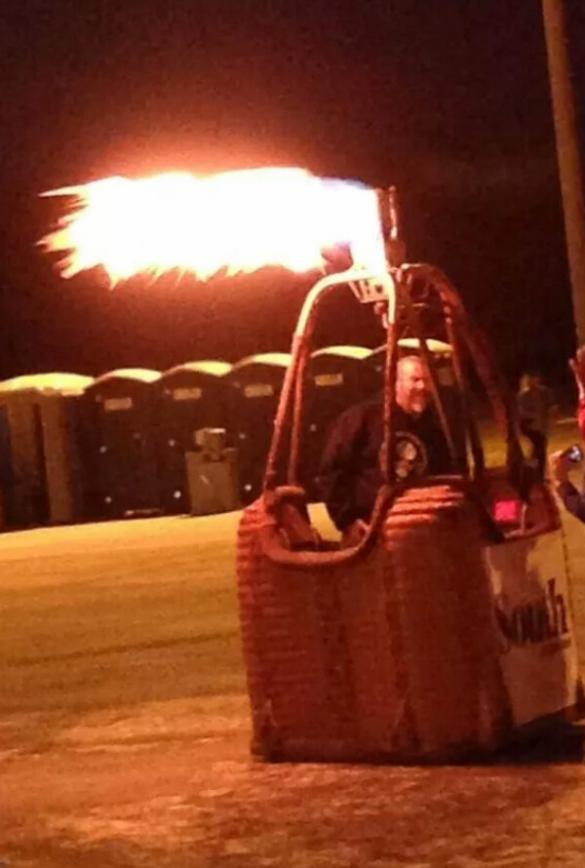
Major Repair?

Slide 31
PARTS
In aviation, safety and reliability are such overriding concerns that all aircraft parts must carry some type of verifiable FAA approval, and we must keep the approval documentation for all the parts currently installed on the aircraft in the aircraft maintenance records.
Unapproved parts are a clear and present danger in aviation. These parts have not been manufactured or tested according to minimum FAA standards. That means they may not perform as well or as long as the same FAA-approved part and that is serious safety concern for everyone.

Slide 32
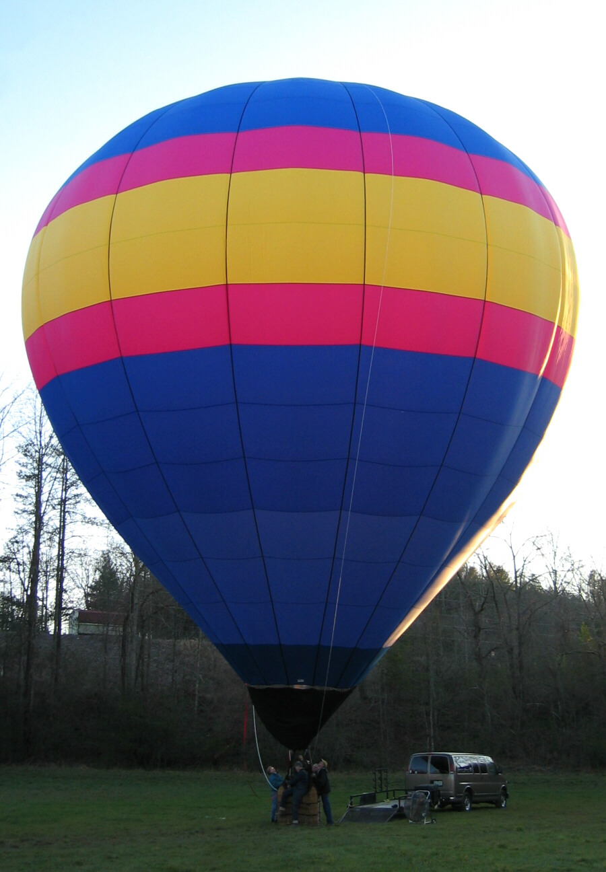
Approved Parts – CFR Part 21
CFR Part 21 Subpart K - Approval of Materials, Parts, Processes, and Appliances
AC 20-62E Eligibility, Quality, and Identifications of Aeronautical Replacement Parts
AC 21-29C Detecting and Reporting Suspected Unapproved Parts

Slide 33
Approved Parts
CFR Part 21.303 - Replacement and modification parts
(a)... no person may produce a … replacement part for sale for installation on a type certificated product unless it is produced pursuant to a Parts Manufacturer Approval (PMA) or...
(1) Parts produced under a Type (TC or STC) or Production Certificate (PC).
(3) Parts produced under an FAA Technical Standard Order (TSO).

Slide 34
Approved Parts
CFR Part 21.305 - Approval of materials, parts, processes, and appliances.
Whenever a material, part, process, or appliance is required to be approved under this chapter, it may be approved --
(a) Under a Parts Manufacturer Approval (PMA)
(b) Under a Technical Standard Order (TSO) issued by the Administrator.
(c) In conjunction with Type Certification (TC & STC) procedures
(d) In any other manner approved by the Administrator.

Slide 35
Unapproved Parts
A part, component, or material that has not been manufactured in accordance with the approval procedures in CFR § 21.305, or has not been repaired in accordance with CFR Part 43;
A part, component, or material that does not conform to an approved type design.
Part with no traceability or approval documentation (Ebay / Hardware store)
Unapproved parts may not be installed on a type certificated product

Slide 36
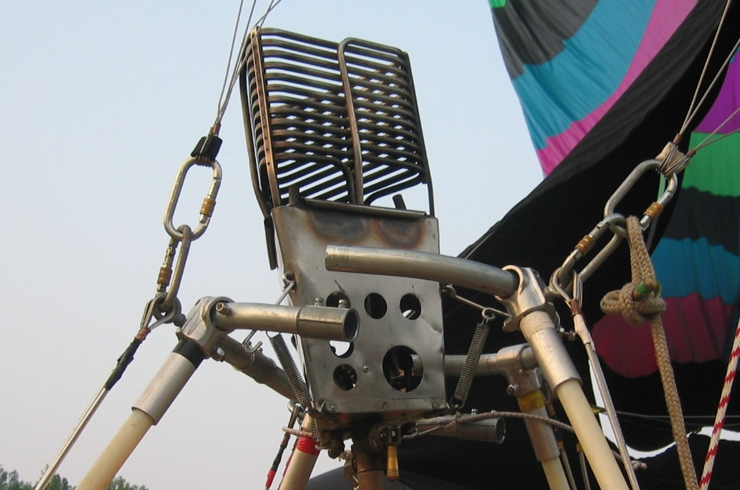

Slide 37
AIRWORTHINESS LIMITATIONS
All Instructions for Continued Airworthiness Manuals (Maintenance Manuals) contain a section of mandatory maintenance items. This section must be followed in ordered to maintain the airworthiness of the aircraft.
These are typically requirements for inspections and replacements of life limited parts.

Slide 38
AIRWORTHINESS LIMITATIONS
CFR Part 31 Appx A A31.4 “The Airworthiness Limitations Section is FAA approved and specifies maintenance required under Part 43.16 and 91.403 of the Code of Federal Regulations.”
CFR Part 43.16 states: “Each person performing an inspection or other maintenance specified in an Airworthiness Limitations section of a manufacturer’s maintenance manual or Instructions for Continued Airworthiness shall perform the inspections or other maintenance in accordance with that section...”
CFR Part 91.403(c) “No person may operate an aircraft for which a manufacturer's maintenance manual or instructions for continued airworthiness has been issued that contains an airworthiness limitations section unless the mandatory replacement times, inspection intervals, and related procedures specified in that section...have been complied with.”

Slide 39
AIRWORTHINESS LIMITATIONS
HEAD BALLOONS, INC. Instructions for Continued Airworthiness page 5 of 30
The Airworthiness Limitations section is FAA approved and specifies maintenance required under Part 43.16 and Part 91.163 of the Code of Federal Regulations.
1. The “O” ring in each Rego 7553T / Sherwood LV-440 blast valve must be replaced and lubricated annually or every 100 hours, whichever comes first.
2. The filter in the pilot light valve(s) must be replaced and the orifice(s) blown out annually or every 100 hours, whichever comes first.
3. The deflation mechanism (Para/Pop Top models) MUST be replaced every 100 hours in service.

Slide 40
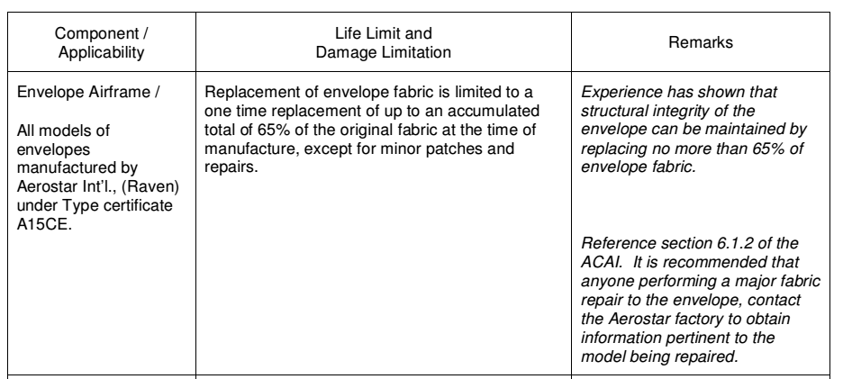
AIRWORTHINESS LIMITATIONS
Aerostar - Instructions for Continued Airworthiness (9/2003)

Slide 41
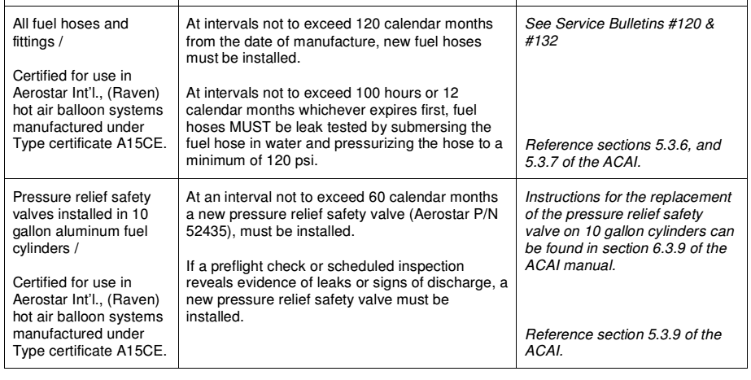
AIRWORTHINESS LIMITATIONS
Aerostar - Instructions for Continued Airworthiness

Slide 42
AIRWORTHINESS LIMITATIONS
LINDSTRAND Balloons Dec 1, 2011
SECTION 2 AIRWORTHINESS LIMITATIONS
2.1 Approval Statement
The Airworthiness Limitations section is FAA approved, and specifies maintenance required under Sections 43.16 and 91.403 of the Federal Aviation Regulations.
2.2 Mandatory Replacement Time
There are no components of any of the Lindstrand range of balloons that are required to be replaced after a fixed length of time.
2.3 Inspection Interval
The inspection interval for Lindstrand balloons is 100 hours of operation, or one year; whichever is the sooner.
2.4 Inspection Procedure
The inspection procedure can be found in Section 6 of this manual.
The inspection checklist is specified in Appendix "A" of this manual.

Slide 43
AIRWORTHINESS LIMITATIONS
LINDSTRAND Balloons Feb 28, 2014**
SECTION 2 AIRWORTHINESS LIMITATIONS
2.1 Approval Statement
The Airworthiness Limitations section is FAA approved, and specifies maintenance required under Sections 43.1 6 and 91 .403 of the Federal Aviation Regulations.
2.2 Mandatory Replacement Time
All fuel hoses, main burner and manifold must be replaced after 10 years in service
2.3 Inspection Interval
The inspection interval for Lindstrand balloons is 100 hours of operation, or one year; whichever is the sooner.
2.4 Inspection Procedure
The inspection procedure can be found in Section 6 of this manual.
The inspection checklist is specified in Appendix "A" of this manual.
2.5 Fabric Replacement
For all models of balloons manufactured by Lindstrand Balloons under Type Certificates B82EU, B87EU and B0001 0CH, replacement of envelope fabric is limited to a one time replacement of up to 65% of the original fabric at the time of manufacture, except for minor patches or repairs.

Slide 44
AIRWORTHINESS LIMITATIONS
FAA Legal Letter of Interpertation (LOI)
http://blog.aopa.org/opinionleaders/2015/06/12/the-back-door-is-locked/?WT.mc_id=150619epilot&WT.mc_sect=blog
On May 21, 2015, AGC-200 issued a Letter of Interpretation (LOI) regarding the “Airworthiness Limitation Section” of the Instructions for Continued Airworthiness (Maintenance Manual). It was five pages long. It closed the “rulemaking backdoor” that some manufactures had been attempting to use to bypass the AD process.
Here’s the Cliff Notes version of the letter’s key points:

Slide 45
AIRWORTHINESS LIMITATIONS
-LOI cont’d
- Under CFR Part 21.31(c), an ALS is part of an aircraft’s type design.
- The only version of an ALS that is mandatory is the version that was included in the particular aircraft’s type design at the time it was manufactured.
- Absent an AD or other FAA rule that would make the new replacement times and inspection intervals retroactive, Cessna’s “after-added” ALS is not mandatory for persons who operate or maintain the Model 210 aircraft, the design and production of which predate the new ALS addition. The “requirements” set forth in the ALS would only be mandatory for aircraft manufactured after the ALS was issued.
- If operational regulations were interpreted as imposing an obligation on operators and maintenance providers to comply with the latest revision of a manufacturer’s document, manufacturers could unilaterally impose regulatory burdens on operators of existing aircraft. This would be legally objectionable in that the FAA does not have legal authority to delegate its rulemaking authority to manufacturers. Furthermore, “substantive rules” can be adopted only in accordance with the rulemaking section of the APA (5 U.S.C. § 553) which does not grant rulemaking authority to manufacturers. To comply with these statutory obligations, the FAA would have to engage in its own rulemaking to mandate the manufacturer’s document, as it does when it issues ADs.

Slide 46
AIRWORTHINESS LIMITATIONS
-LOI cont’d
The bottom line is : Manufacturers of Type Certificated aircraft are not permitted to impose regulatory burdens on aircraft owners by changing the rules in the middle of the game. Only the FAA may do that, and only through proper rulemaking action that complies with the Administrative Procedures Act (APA) (including its notice-and-comment provisions and other safeguards). If you ever encounter a situation where the manufacturer of your aircraft tries to do this, call them on it—the FAA lawyers will back you up.
You can read the entire LOI in all of its lawyerly glory here:
http://www.faa.gov/about/office_org/headquarters_offices/agc/pol_adjudication/agc200/interpretations/data/interps/2015/new-tennessee%20aircraft%20services%20-%20%282015%29%20legal%20interpretation.pdf

Slide 47
Instructions for Continued Airworthiness
This concept also holds true for all maintenance. The only ICA that you are required to use to maintain your aircraft is the ICA that was valid at the time the aircraft was built.

Slide 48
Performance rules
CFR Part 43.13
(a) Each person performing maintenance, alteration, or preventive maintenance on an aircraft shall use the methods, techniques, and practices prescribed in the current manufacturer's maintenance manual or Instructions for Continued Airworthiness prepared by its manufacturer, or other methods, techniques, and practices acceptable to the Administrator.
The manual that was valid when your balloon was built is still considered by the FAA as “acceptable” data.

Slide 49
Hybrid Balloon Systems – STC's
Most Type Certified balloon manufacturers have STC's (Supplemental Type Certificates) allowing the use of other manufacturer's baskets & burners.
Head – Adams, Aerostar, Cameron, Firefly, Lindstrand, Raven, Sky and Thunder & Colt.
Aerostar – Cameron, Firefly, Lindstrand and Thunder & Colt
Cameron – Aerostar, Firefly, Lindstrand, Raven, Sky and Thunder & Colt
Firefly – Aerostar, Cameron, Raven and Lindstrand
Lindstrand - Aerostar, Cameron, Raven and Thunder & Colt
National - Firefly

Slide 50
Hybrid Balloon Systems - STC's
STC's are listed on the FAA's Regulatory & Guidance Library website – http://rgl.faa.gov
There are also many other STC's listed for all sorts of modifications that have been done to balloons.
How can you use an STC?

Slide 51
Hybrid Systems -STC requirements
Authorization – In order to use an STC, you will first need to get authorization from the STC holder.
CFR Part 91.403(d) “A person must not alter an aircraft based on a supplemental type certificate unless the owner or operator of the aircraft is the holder of the supplemental type certificate, or has written permission from the holder”
Installation – After getting authorization, the STC will need to be “installed” to the balloon. This may be a simple matter of a logbook entry, entering the use of the STC. Some installations may require new suspension lines to the basket. The installation of an STC will require a sign off by an FAA Certified Mechanic.
Flight Manual Supplement – In addition to your normal Balloon Flight Manual, you will also need to carry a Flight Manual Supplement which details the differences in the basket & burners. This would be obtained from the STC holder.

Slide 52
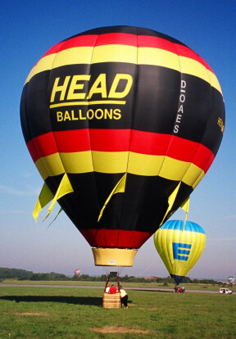
Hybrid Balloon Systems
– STC's
The STC makes the other manufacturer's baskets & burners approved equipment for your brand of balloon (envelope). So, now you have the original brand basket/burner and the new brand of basket/burner both approved for use. A Private or Commercial Pilot may exchange any approved baskets with a signature under CFR Part 43 - Preventative Maintenance.

Slide 53
QUESTIONS ?
Soft Landings

Slide 54
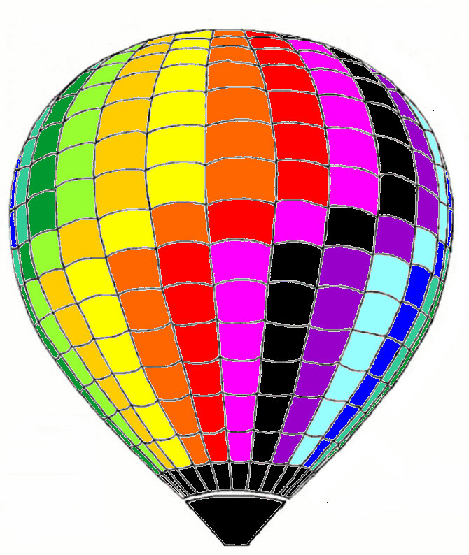
Download this power point presentation at:
http://www.headballoons.com/Seminar.html
FOR SALE
105 90

